Slide 1
Arduino Workshop
Session 2

Slide 2
Contents
Buzzer
Servo motor
Ultrasonic
Relay module
PIR sensor (Motion)
Flame sensor

Slide 3

Buzzer

Slide 4
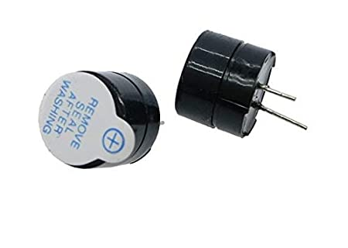
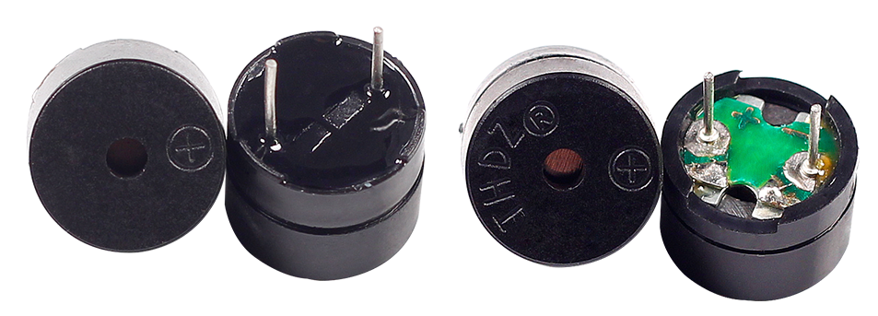
Buzzer
Buzzer is basically a beeper.
Types:
Active Passive

Slide 5
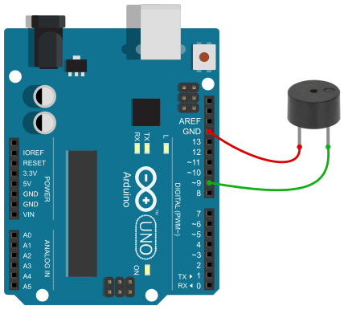
Connection

Slide 6
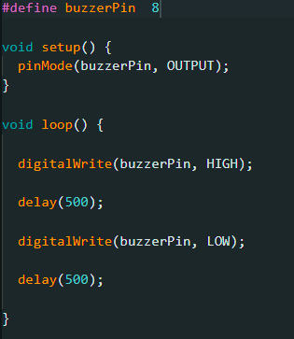
Active Vs Passive
Active
Need a DC voltage to produce sound.
Only one tone is possible.

Slide 7

Active Vs Passive
Passive
Need an AC voltage to produce sound.
Uses a square wave signal.
The tone can be changed.

Slide 8

Buzzer
Lets make some noise 😤

Slide 9

Servo motor

Slide 10
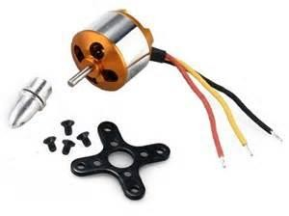
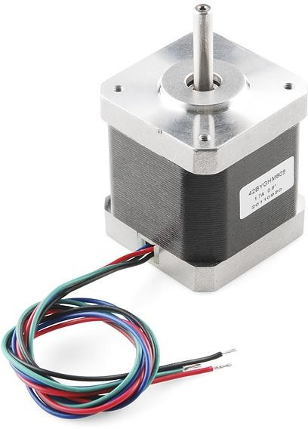
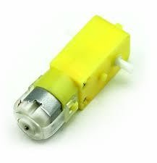
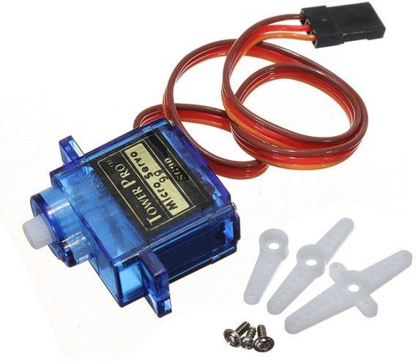
Motors
Different types of motors:
Brushless motor
Stepper motor
DC motor
Servo motor

Slide 11

Advantages
Allow you to precisely control physical movement.
Generally move to a position rather than continuously rotating.
Simple to connect and control.
The motor driver is built right into them.

Slide 12
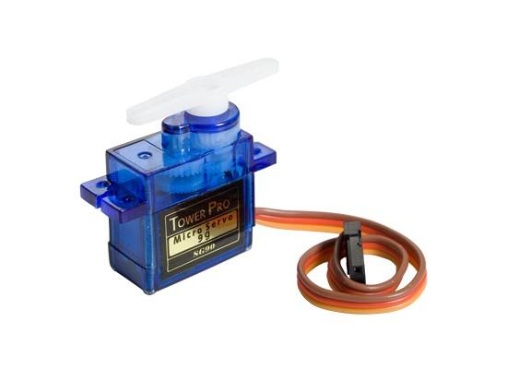
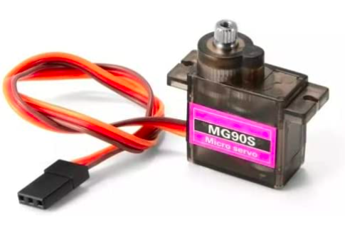
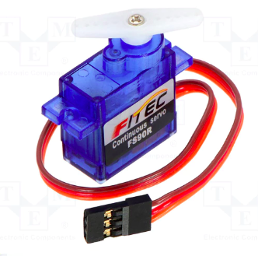
Servo motors
Different types & shapes:
Most Common

Slide 13
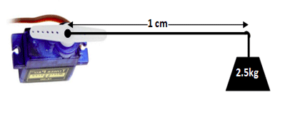
Servo motors
How to choose the motor ??
According to your application you can choose the motor with the torque and speed needed.

Slide 14
Interior
Contain a small DC motor connected to the output shaft through gears.
The output shaft drives a servo horn and is also linked to a potentiometer (pot).

Slide 15
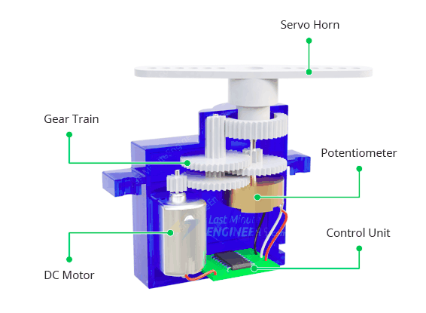
Interior

Slide 16
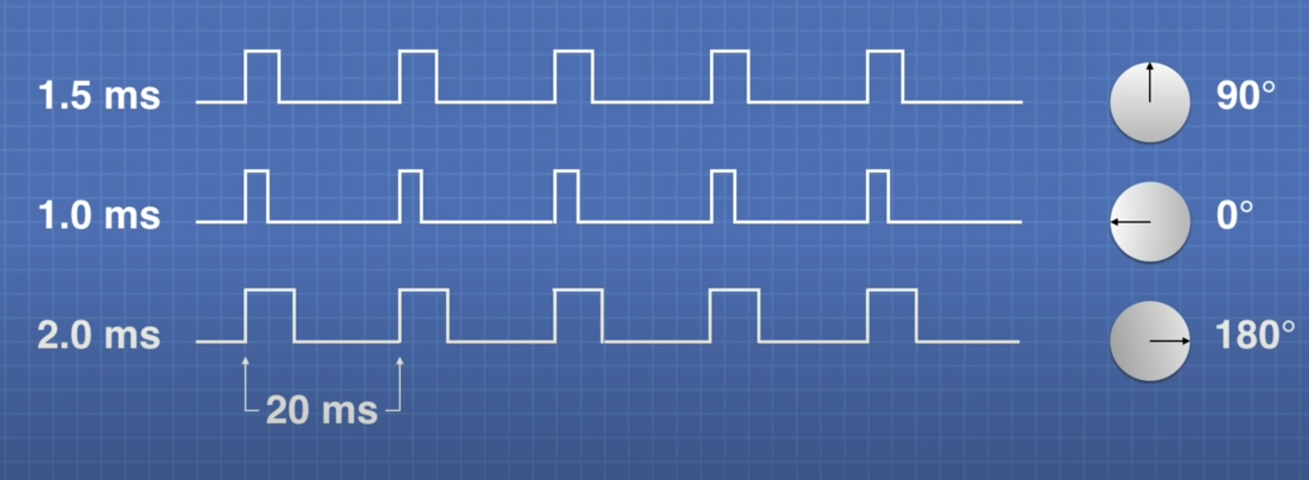
Mechanism

Slide 17

Mechanism

Slide 18
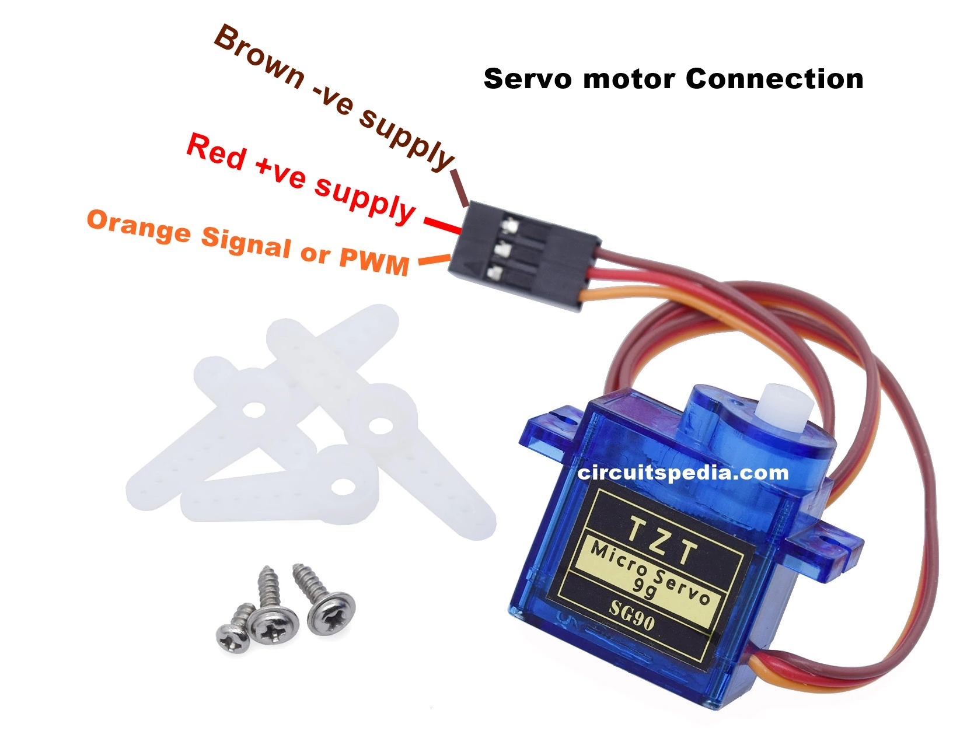
Connection

Slide 19
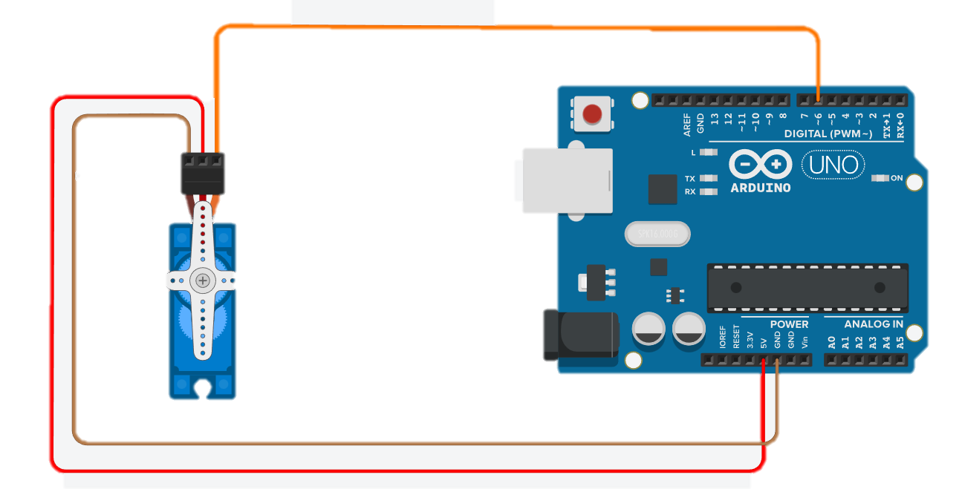
Connection

Slide 20
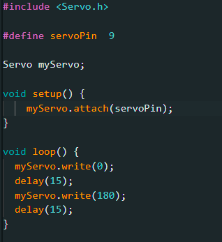
Coding
Library calling
Pin declaration
Declaring an object called myServo
Pin definition (as pinMode)
Moving the servo to the angle 0
Moving the servo to the angle 180

Slide 21
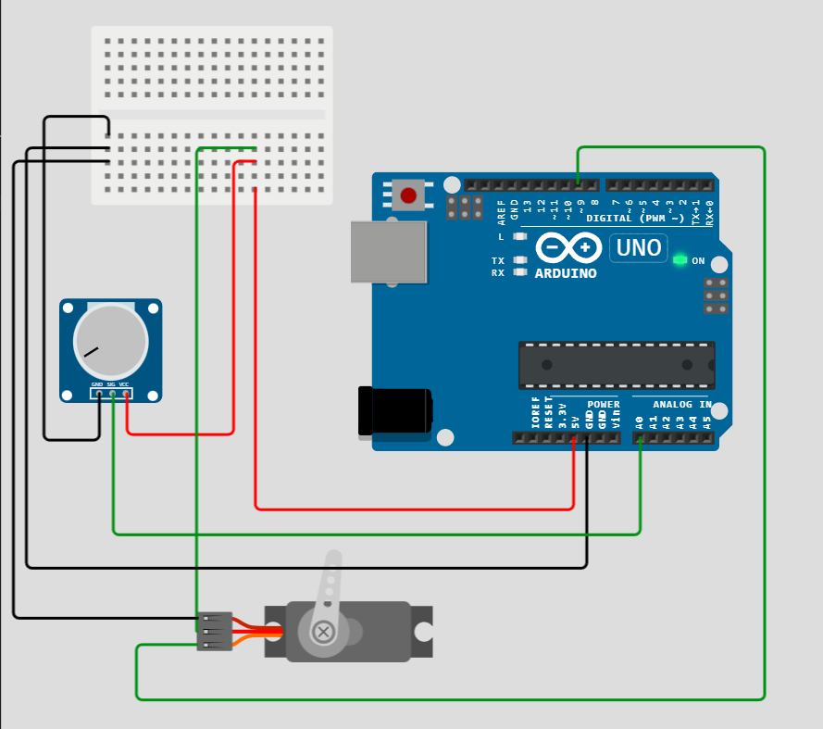
Exercise 1
Use a potentiometer to control the servo motor.

Slide 22
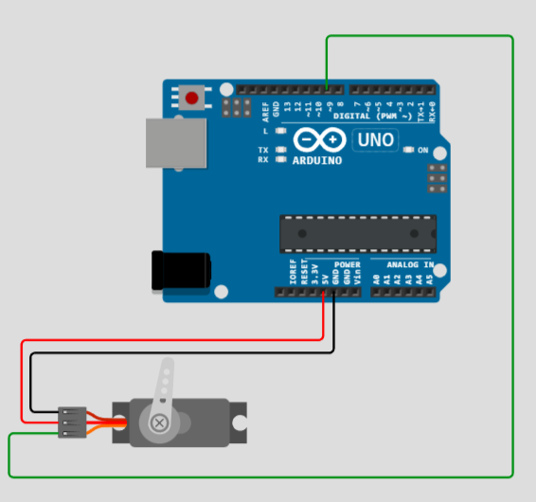
Exercise 2
Make the motor move from 0 to 180, then move from 180 to 0.
Use delay to make it move smoothly.

Slide 23
Ultrasonic sensor

Slide 24
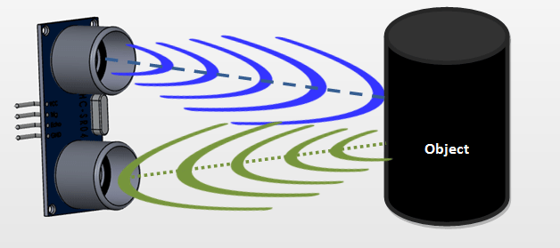
How it works

Slide 25
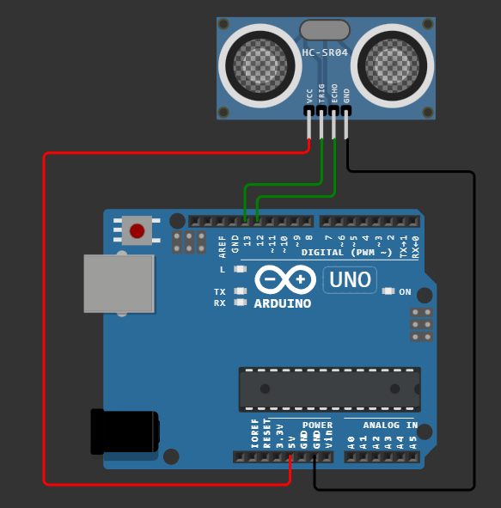
Ultrasonic wiring
Connection:
VCC = 5V
GND = GND
Trig = OUTPUT pin
Echo = INPUT pin

Slide 26
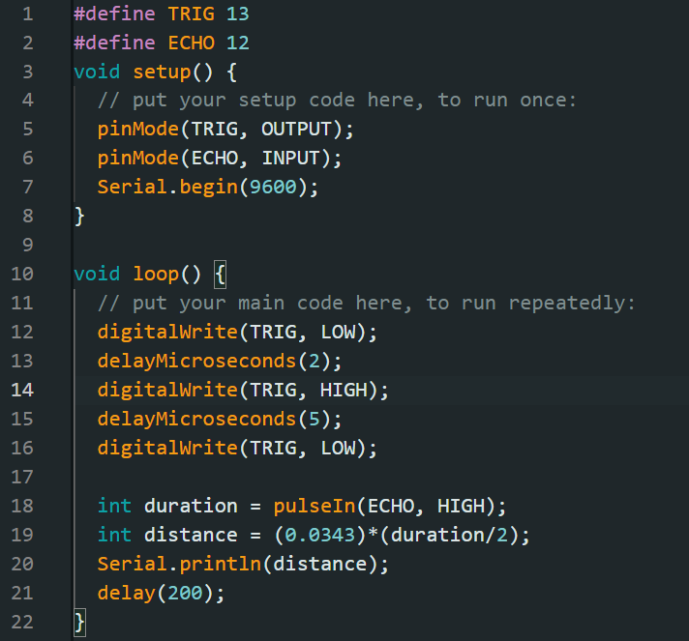
Ultrasonic -Code

Slide 27
Relay module

Slide 28
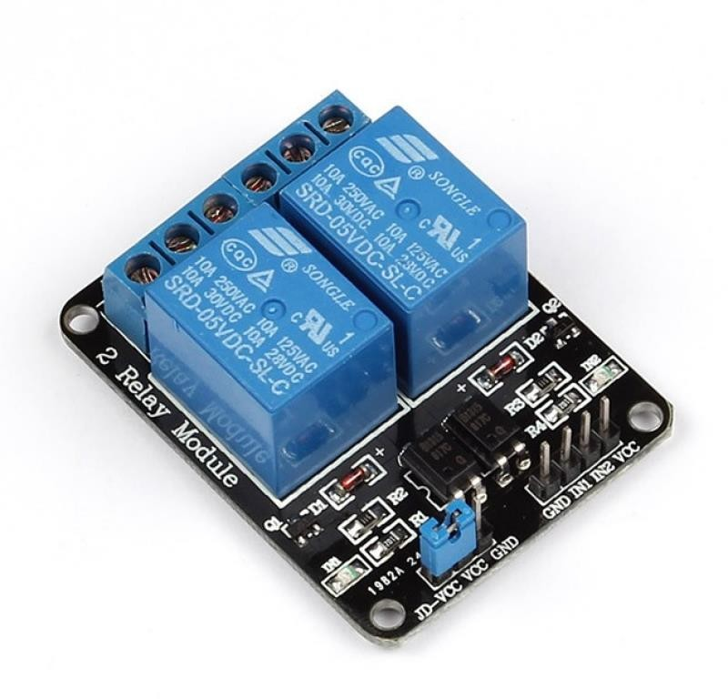
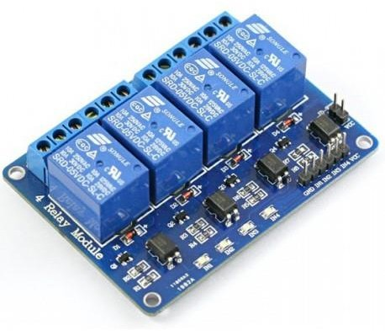
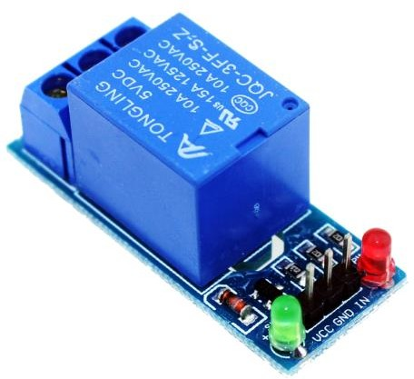
Relay Module

Slide 29
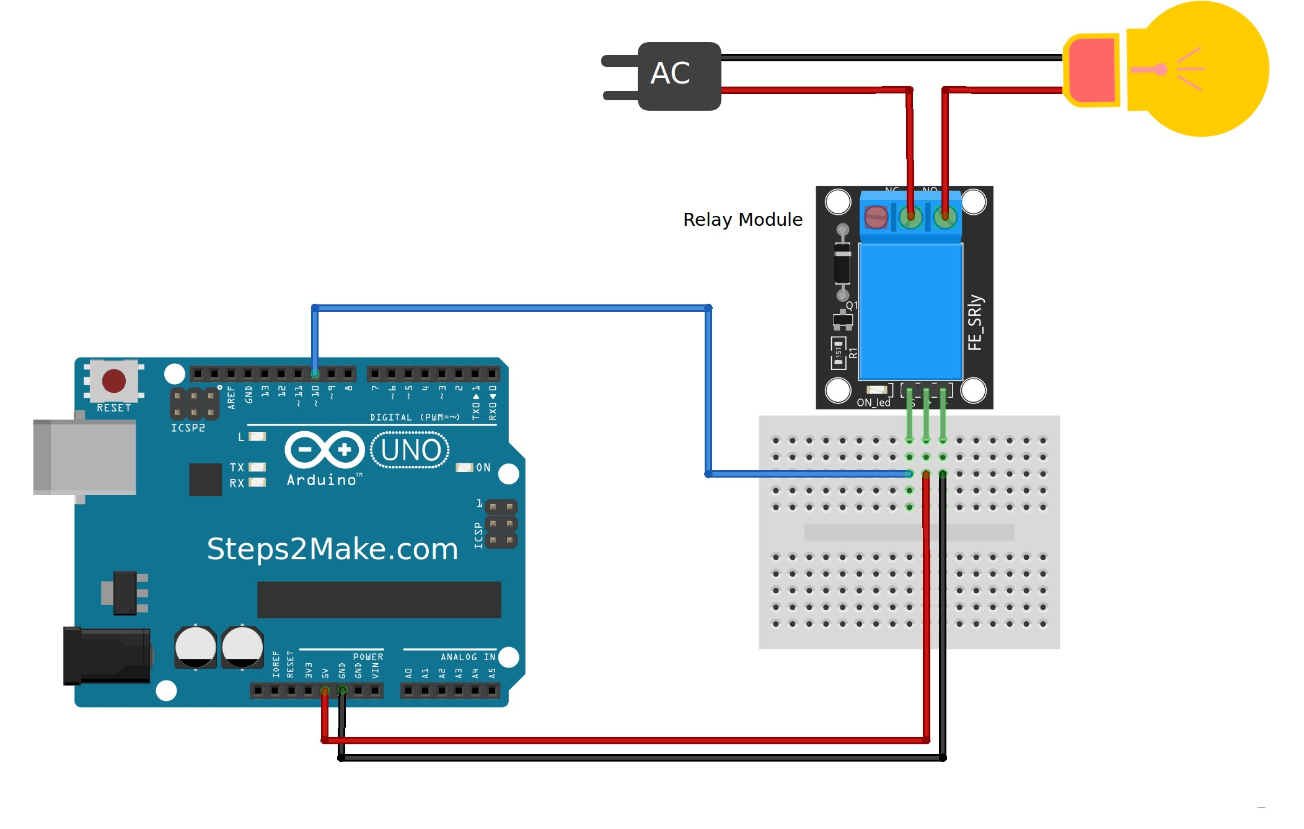
Relay module -Circuit

Slide 30
PIR (Motion sensor)

Slide 31
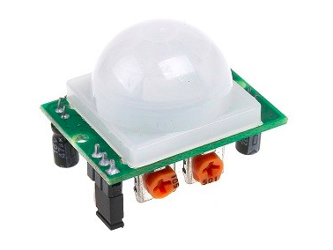
Introduction
Used to detect motion of objects.
Stand for “Passive Infrared”.
Basically, it measures infrared light (IR) from objects in its field of view.

Slide 32
Advantages
Small in size.
Wide lens range.
Easy to interface.
Inexpensive.
Low-power.
Easy to use.
Do not wear out.

Slide 33
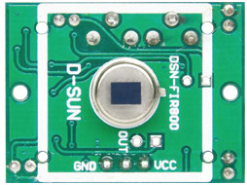
Interior
1- Pyroelectric sensor.
2- Two built-in potentiometers to adjust the delay time and
the sensitivity.
3- Fresnel lens.
3
1
2

Slide 34
Mechanism
Everything emits low-level radiation.
The hotter something is, the more radiation is emitted.
The sensor in a motion detector is split in two halves.
If one-half sees more or less IR radiation than the other, the output will change.
So its used to detect the change in objects motion.

Slide 35
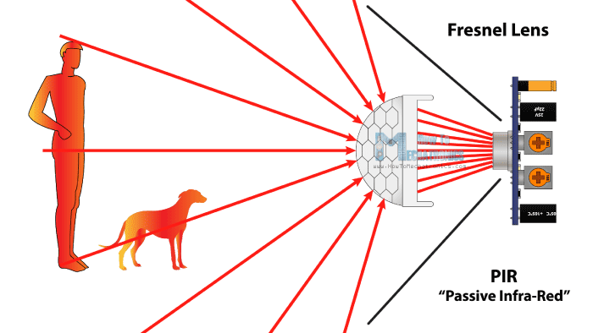
Mechanism

Slide 36
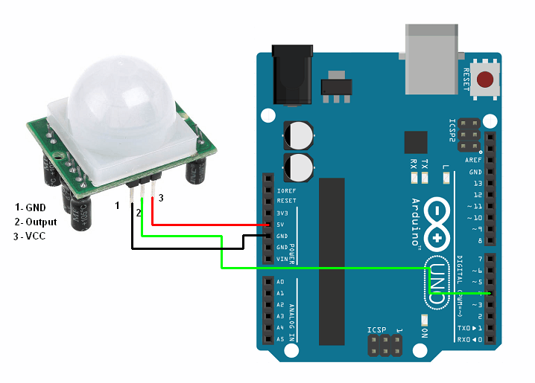
Connection

Slide 37
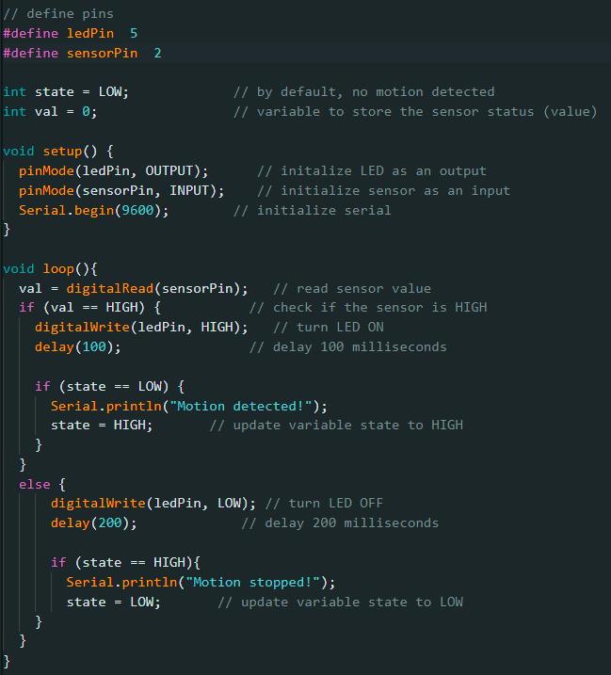
Coding

Slide 38
Flame sensor

Slide 39
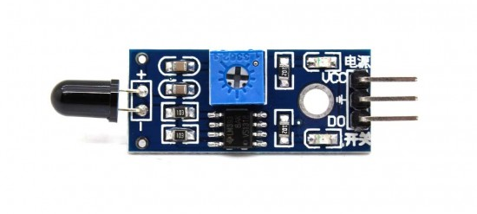
Introduction
A flame detector is a sensor designed to detect and respond to the presence of a flame or fire.
Mainly it is a Photodiode (IR receiver).

Slide 40
Advantages
Detects a wavelength in the range of 760nm-1100 nm.
Detection range up to 50 cm. (Adjustable)
Detection angle about 60 degrees.
Operating voltage 3.3V-5V.
Digital and Analog Output.
Cheap.
Easy to use.

Slide 41
Mechanism
When fire burns it emits Infra-red light, this light will be received by the Photodiode (IR receiver) on the sensor module.
Then we use an Op-Amp to check for a change in voltage across the IR Receiver.
If a fire is detected the output pin will give 5V(HIGH).
If there is no fire the output pin will be 0V(LOW).

Slide 42
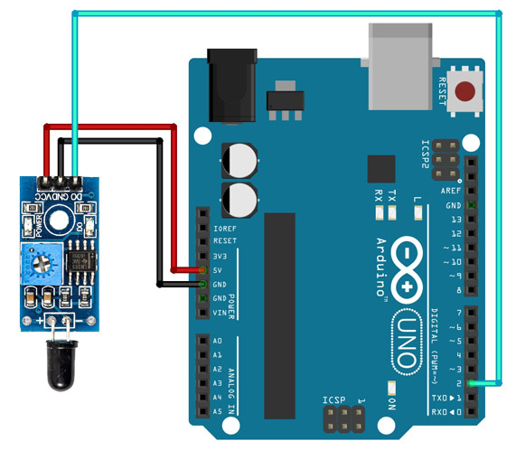
Connection

Slide 43
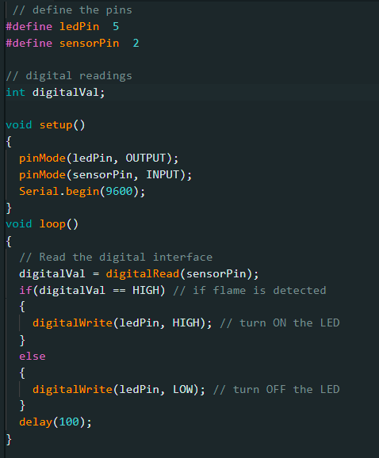
Coding

Slide 44
Any Questions..?

Slide 45
Thank You

